Slide 1
List of Top 15,000 Anime and Japanese Animated Works From MyAnimeList
Sean Zhang

Slide 2
Mini-Update #1

Slide 3
Data Profile
The table of anime was taken from the website MyAnimeList. It consists of the top 15,000 anime entries by score. There are multiple columns such as English and Japanese names, average episode duration, popularity, number of times favorited/scored, age rating, and more. Of note genres, rank, premiered, producers, and studios are some important columns that can have missing values. Also, the premiered column is in the format [season]_[year] (ex. Fall 2018), so that will need to be cleaned when processing the date.

Slide 4
Data Profile
Column Name | Has missing value? | Data Type(Discrete or numeric or free text) | Useful? | Need cleaning or processing?
anime _id | no | Discrete | no | no
anime_url | no | Free text | no | no
image_url | no | Free text | no | no
name | no | Free Text | yes | no
english_name | yes | Free Text | no | no
japanese_name | yes | Free Text | no | no
score | no | Numeric | yes | no
genres | yes | Free Text | yes | yes
synopsis | no | Free Text | no | no
type | no | Free Text | yes | no
episodes | no | Discrete | yes | no

Slide 5
Data Profile
Cont.
Column Name | Has missing value? | Data Type(Discrete or numeric or free text) | Useful? | Need cleaning or processing?
premiered | yes | Free Text | yes | yes
producers | yes | Free Text | yes | yes
studios | yes | Free Text | yes | yes
source | no | Free Text | yes | no
rating | no | Free Text | yes | no
rank | yes | Discrete | yes | no
popularity | no | Discrete | yes | no
favorites | no | Discrete | yes | no
scored_by | no | Discrete | yes | no
members | no | Discrete | yes | no

Slide 6
Questions
What is the breakdown of genres and their change through time?
Number of anime series premiered per season?
Average score of all anime by season?
Relationship between studios and score?
Proportion of anime series being source from manga/games/novel vs original?
Relationship between popularity and score?
Do some studios prefer working on certain genres?
How many anime movies are being made vs TV

Slide 7
Audience and Communication Goals
The audience for my data stories of the anime dataset would be other people who watch anime either as new or old watchers. Personally, I don’t watch anime as often as I used to, and believe that the quantity and anime has increased while the quality and uniqueness has done down. I do believe this sentiment is shared by the audience of anime watchers, as I have observed similar criticisms, especially regarding anime falling into similar tropes. I would like to communicate this perspective to other anime watchers, even if there is not much that can be done to shift how the industry is currently structured. However, it still may make some people more discerning when it comes to what anime to be fans of, so that studios would be encouraged to adapt/create more poignant, meaningful, well-written works.

Slide 8
Mini-Update #2

Slide 9
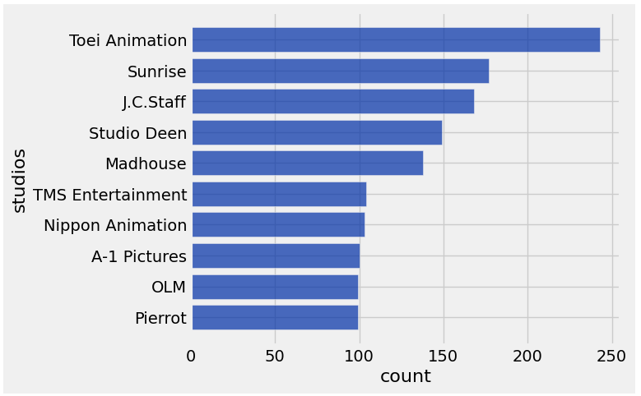
Insight 1: Top 10 studios based on # of anime (TV) series made
-The smallest value (OLM and Pierrot) is 99 series
-The largest value is Toei Animation’s 243 series
-Toei leads substantially over second place (Sunrise has 177), which can be attributed to the fact that Toei was established in 1948
-There is another fallout in series # starting from TMS downwards

Slide 10
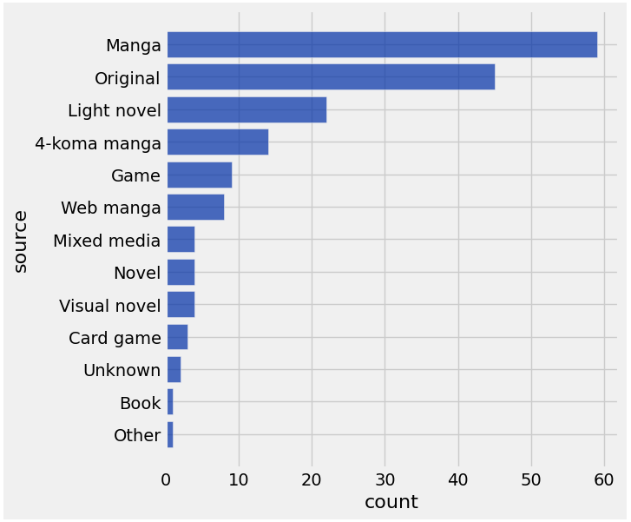
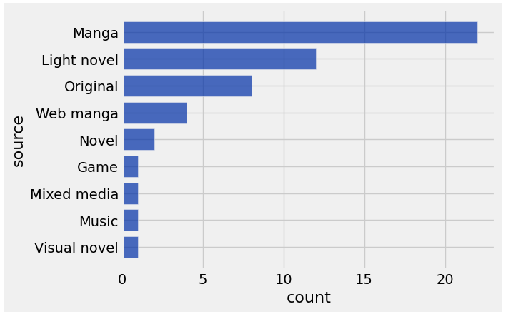
Insight 2: What anime works were sourced from 2015 vs 2025
2015
2025

Slide 11
Insight 2: What anime works were sourced from 2015 vs 2025 Cont.
-The overall amount of anime works created in 2015 was substantially more than 2025, out of the top 15,000 rows
-Surprisingly, unlike 2015, 2025 is completely absent of anime adapted from 4-koma manga (a short, usually comedic manga format)
-Series are still adapted from Manga the most in both graphs, however, original works was 2nd in 2015 while it is 3rd in 2025, switching places with light novels. This could be a indication that studios prioritized already created works rather than working with an original story concept

Slide 12
Progress
-This week, I created some smaller tables from the dataset, such as top 10 studios based on Anime (TV) count, and 2015/2025 anime works based on source, along with their bar graphs
-I think a couple of obstacles I will run into as I make more complex data insights would be processing the aforementioned multivalued columns as well as making graphs that compare seasons instead of just the year.
-I used prior labs as well as the datascience documentation online to get the syntax to create tables, graphs, and using functions

Slide 13
Feedback
I was given feedback that I didn’t follow the format of creating a table with rows describing each column in the anime dataset, so I created and filled it this week. It was useful since that was a big error on my part for following the slides too loosely. I also had more minor feedback on my title and audience and communication goals, so I gave more detail this week.
I would like more feedback relating to the audience’s perspective, as I feel the most difficult part of the project is knowing how the reader would comprehend my visuals and data stories if they don’t know much about anime. It would also keep my graphs focuses on what the audience is interested in relating to the anime industry

Slide 14
Mini-Update #3

Slide 15
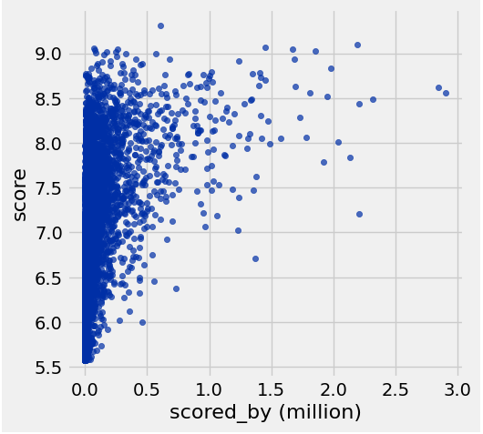
Insight 1: Amount of Scores Relation on an Anime’s Average Score
-On the left part of the scatterplot, for anime that are not scored that much, there is no strong correlation between that and the average score
-A large majority of the 15,000 anime entries are scored by less than 500,000 people
-Indicates of trend of anime being score the most also having a higher score, with none after 1.5 million scoring being below a 7.0

Slide 16
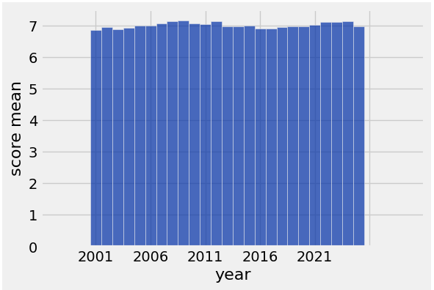
Insight 2: Average Score of Anime by Year Premiered (2001-2026)
-There is no dramatic shift in average score based on the year, with scores reliably averaging around 7
-However, there seems to be a small dip in average scores that increase from 2001 to 2009
-There is another small dip where scores fall below 7 in between 2012 and 2021

Slide 17
Progress
-This week, I creating a couple more tables that specialized in what I was going to make a graph of, like creating another column that had just the year instead of “[season]_[year]”. I created on insight on the relationship between avg score and score number, and an insight on avg score and year premiered
-Some rows didn’t have a value for the year premiered column, so I used the where function to clean them before graphing. I still think it will be challenging to extract genres in following weeks as the columns have multiple values
-I used the last mini-update and and datascience documentation online for how to manipulate the tables and make graphs. I searched online on how to slice strings when making the year column

Slide 18
Feedback
-Last week, I received feedback from the professor about using a scatter plot instead to graph the difference between 2015 and 2025 anime sources
-I don’t believe that a scatter plot would be appropriate in that specific insight since one of the axis is categorical data, however, I used a scatter plot this week, which I think aptly displayed the relationship between score and score number
-Any additional feedback on the readability of the graphs or if there is a mor effective way of displaying them would be appreciated

Slide 19
Mini-Update #4

Slide 20
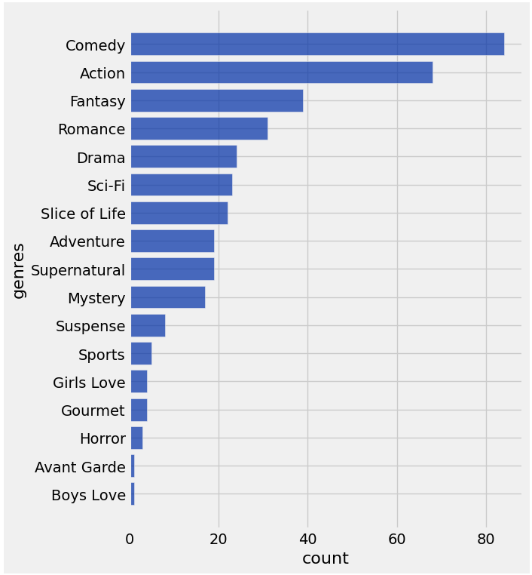
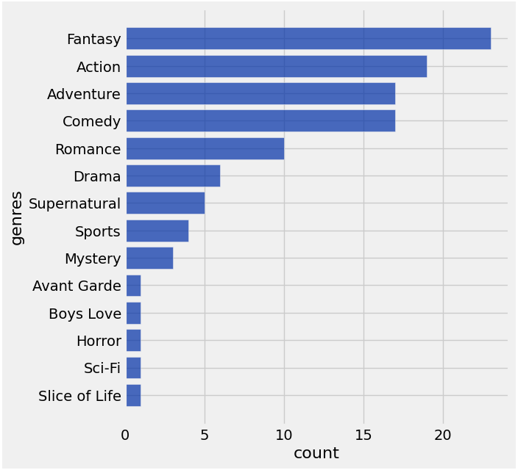
Insight 1: Genres of all works 2015 vs. 2025
2015
2025

Slide 21
Insight 1: Genres of all works 2015 vs. 2025 cont.
-The overall amount of anime released during 2015 was substantially higher than 2025, with the former’s top genre being >80 while the latter’s being only >20
-From 2015-2025, Comedy has dropped from the top, being replaced by Fantasy. Also, Adventure has risen while Slice of Life has fallen dramatically, indicating an industry shift to more serious narratives
-2025 is missing some genres (Girls Love, Gourmet, and Avant Garde, Suspense)

Slide 22
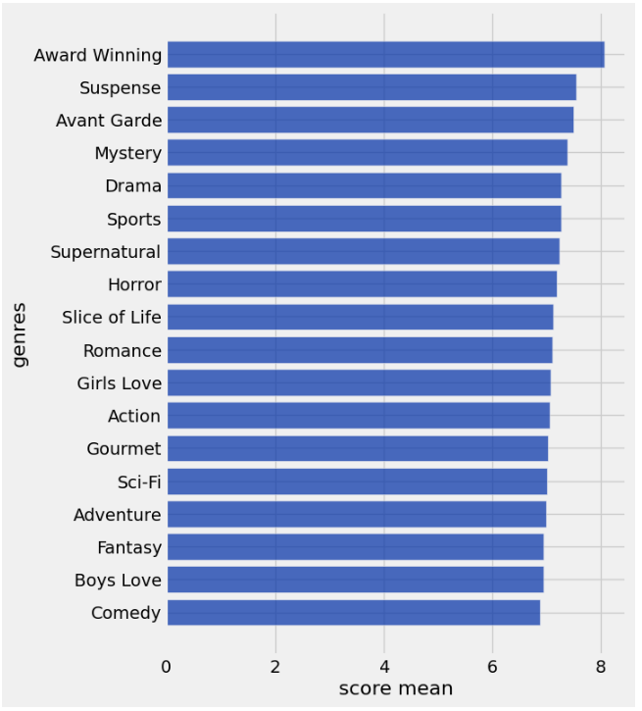
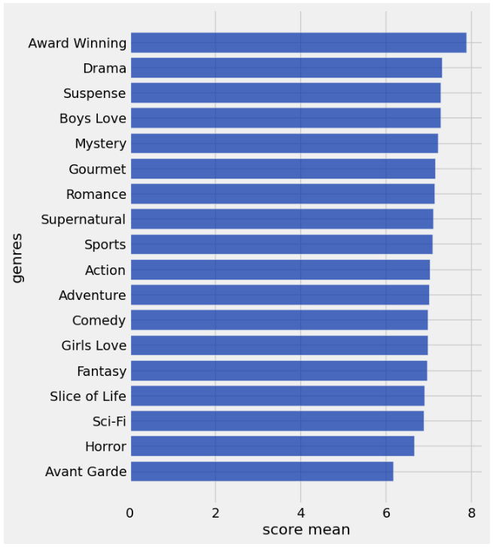
Insight 2: Mean score by genre from 2004-2014 to 2015-2025
2004-2014
2015-2025

Slide 23
Insight 2: Mean score by genre from 2004-2014 to 2015-2025 cont.
-Mean score of genres in 2004-2014 were overall significantly higher than 2015-2025
-Despite Action, Adventure, Comedy, and Fantasy usually having the most series; they are in the bottom half of mean scores for both periods. Drama, Suspense, and Mystery have been consistently top scored
-Notably, Avant Garde dropped from the #3 spot to the bottom, possibly due to a decrease in quality of works within the genre
-In contrast, Boys Love rose greatly from second from the button to #4 which may be due to better quality or more progressive attitudes from audiences

Slide 24
Progress
-This week, I made another table that denormalized the original anime table based on genre. This was so the genre column would no longer have multiple values
-I created an insight that compared the popularity of anime works in the year 2015 vs. 2025 and one that compared the mean score of genres of anime during the 2004-2014 period vs 2015-2025 period
-I’m not so sure of my abilities to effectively tell a data story of my insights, but the next lecture will help
-I used the pandas library for denormalization, datascience documentation for groups, and the last weeks anime table that added a year column

Slide 25
Feedback
-Last week, I received feedback from the professor about one-hot coding the table so that there would be extra columns for each genre with either a 1 or 0
-I tried looking in the datascience documentation but found that using the pandas package’s explode method to denormalize the anime table would be easier to plot
-Since we are starting the data stories, I would like to know if I am clear or giving enough context to have my explanations make sense

Slide 26
Mini-Update #5

Slide 27
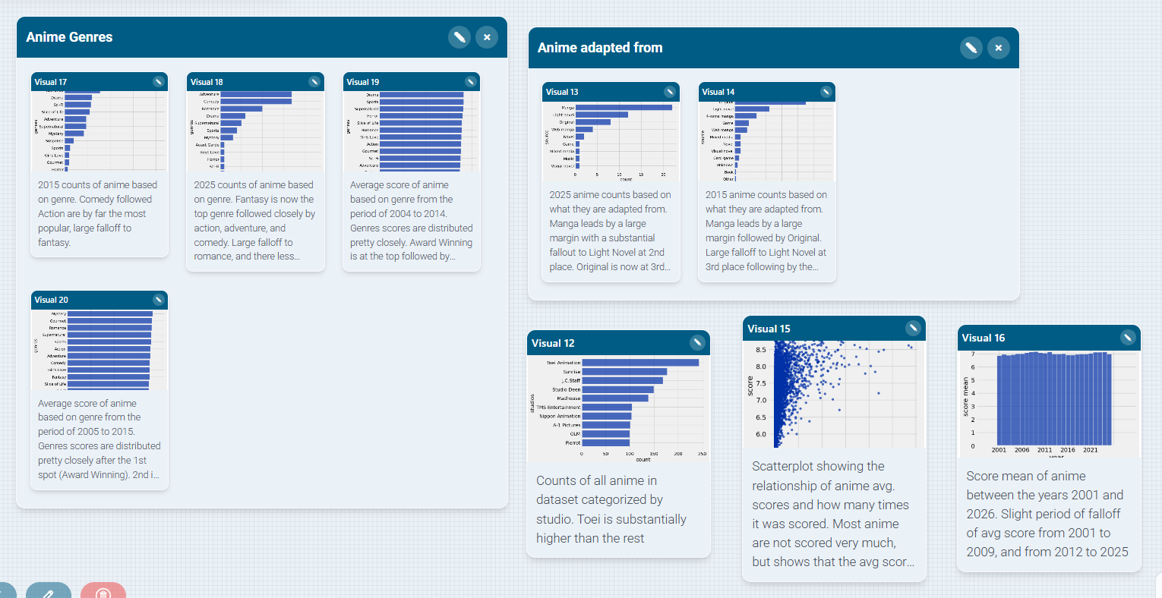
Cast Studio Storyboard Screenshot

